Slide 1
Simplified Data Driven Approach to Predict Success Of Bank Outbound Campaign
Victoria, Cesar, Stela, Kaushik
Notes:
-Our project was about using data driven approach, utilising machine learning, to help banks run effective direct marketing campaigns by targeting the right potential customers.

Slide 2
Agenda
What exactly is the problem?
Data Overview
Ask and ye shall receive!
Who should we target?
Why those specific demographics?
When should we target them?
Why are those economic indicators important?
What else can we do?
To Reiterate
Notes:
-Overview of the problem statement and data
-Who should be targeted and why
-When should customers be targeted and why
- Recap

Slide 3
What’s the problem?
“With the data collected, can we predict the willingness of a customer to open a term deposit account?”
Notes:
- Direct marketing campaigns can be extremely expensive so banks need to have confidence that the sample of potential customers they contact will yield a high number of new customers.
-The focus of this problem is getting customers to sign-up to term deposit accounts.
- So, what is a term deposit account? A term deposit account is a personal short to medium term savings account - these accounts generally have a high interest rate compared to standard savings accounts.
-Generally banks try to recruit new term deposit customers by calling customers from an existing customer database with the aim of attempting to get these individuals to sign-up to an account.

Slide 4
Data Overview
Source: [Moro et al., 2014] S. Moro, P. Cortez and P. Rita. A Data-Driven Approach to Predict the Success of Bank Telemarketing. Decision Support Systems, June 2014 - UCI Data Repository
Data collected from 2008 - 2010
41k existing customers targeted
21 attributes reviewed including personal demographics, economic indicators and campaign logistics
Notes:
Let’s talk about the good stuff - what about the data?
We found the data on the UCI (University of California at Irvine) data repository along with a published paper
The data was collected between 2008 to 2010 in Portugal for a Portuguese bank
A total of 41k customers targeted as part of a series of direct marketing campaigns - however, our analysis showed that very few customers contacted actually signed-up to a term deposit account.
The dataset contains 21 variables including demographic information (for example - age, job status, education), campaign logistics (for example - day of the week, month) and economic indicators (for example - Euribor rate, employment rate, consumer confidence index)

Slide 5
Result
Prediction with 89% accuracy
Age and Euribor Rate are really important
Focus on who to call
Focus on when to call
Notes:
- What did we discover?
- By training and testing a Random Forest model we were able to predict whether a potential customer would sign-up to a term deposit account with an accuracy rate of 89% which we believe is a good solid result
- The two most important variables in the model were Age and the quarterly Euribor rate at the time of the campaign
- It’s clear then that there are two key factors when deploying direct marketing campaigns: 1) who - what is/are the demographic profiles of a term deposit customer? 2) when - what is the best economic environment for delivering a successful campaign?

Slide 6
Who should we target?

Slide 7
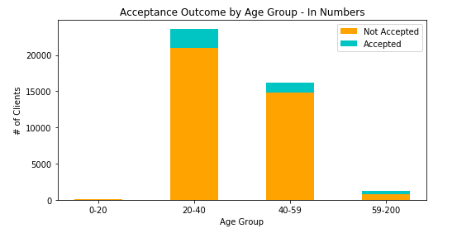
Focus: 20 - 40 years of age

Slide 8
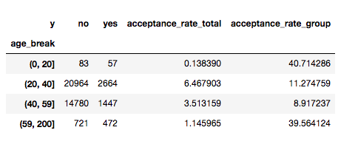
New Target: 59 years & Older

Slide 9
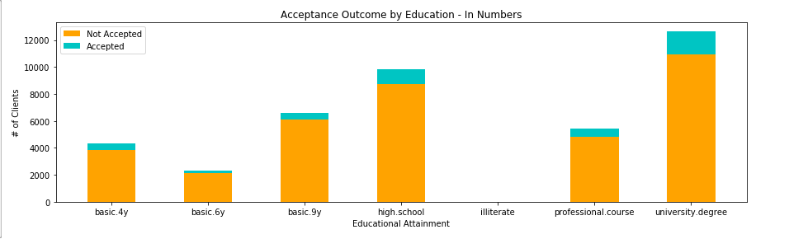
Focus: Customers with an University Degree

Slide 10
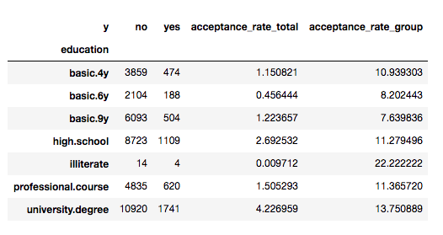
New Target: Other segments too

Slide 11
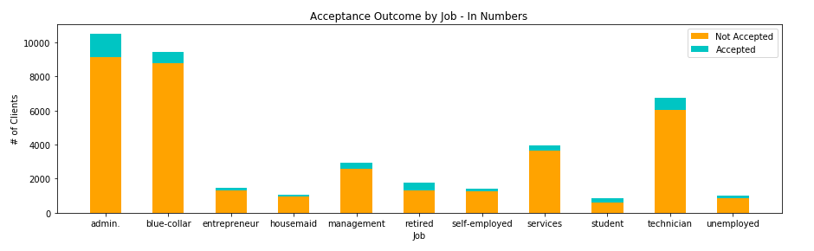
Focus: Customers with an Administrative Job

Slide 12
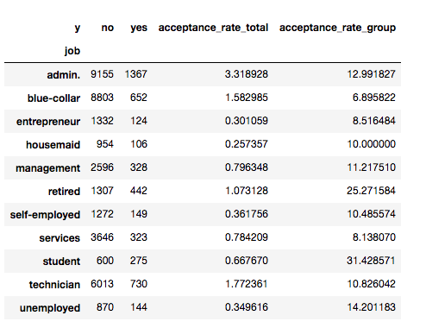
New Target: Customers who are Retired

Slide 13
Why those specific demographics?
Concerned about their future finances, due to the market condition
Access to disposable income, due to their education and job prospects
Not as affected by the 2008 crash as other customer segments

Slide 14
When should we target?

Slide 15
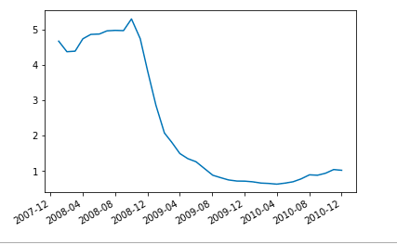
Euribor Rate Was Lower than Normal
Notes:
Right in the middle of the 2009 European Debt Crisis
Portugal was one of those hardly hit (2nd after Greece)
Explain Euribor rate
Bank

Slide 16
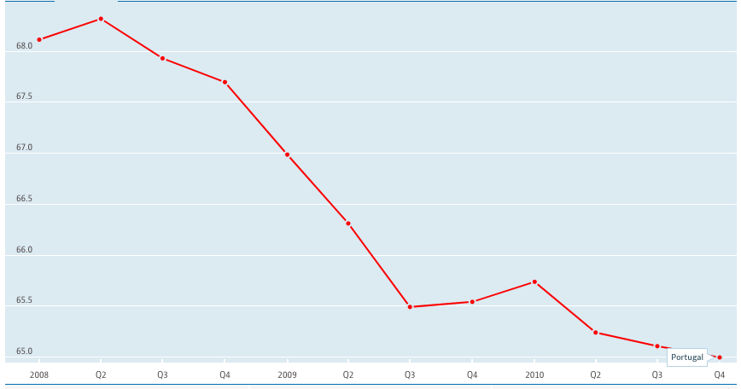
Employment Rate is not ideal
OECD (2018), Employment rate (indicator). doi: 10.1787/1de68a9b-en (Accessed on 07 August 2018)

Slide 17
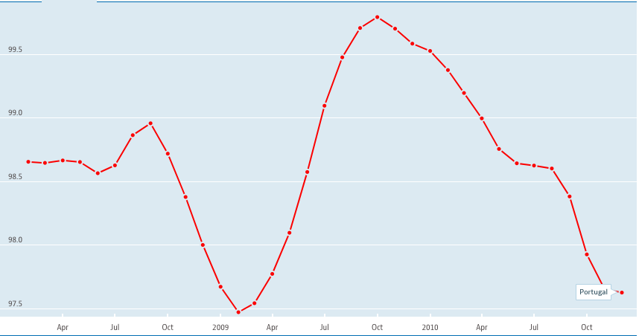
Consumer Confidence Index Was Close to Average
OECD (2018), Consumer confidence index (CCI) (indicator). doi: 10.1787/46434d78-en (Accessed on 07 August 2018)

Slide 18
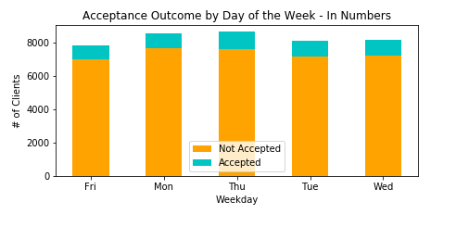
Thursdays Are Better

Slide 19
Why are those economic indicators important?
Indicators should be viewed from all angles
Stable job prospects, at least for certain segments
Better income to expenses ratio

Slide 20
What else can we do?
Notes:
The entire goal is to increase the ROI and revenue pontential and reduce campaign cost

Slide 21

Start with a simple survey
Notes:
The first step to create a better pool of target clients, we can run surveys in different medias to :
better target clients and
reduce touch points

Slide 22
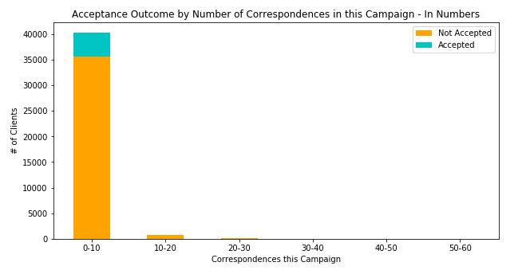
Further reduce number of touchpoints
Notes:
Also target customers that have previously accepted our offers; this helps reduce the number of touchpoints further.
This will further maximize our ROI for the campaigns

Slide 23
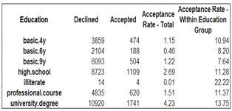
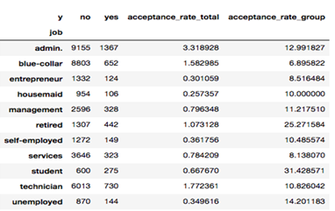
Target underserved customer segments
Notes:
Also focus on the student, retired, unemployed, etc

Slide 24
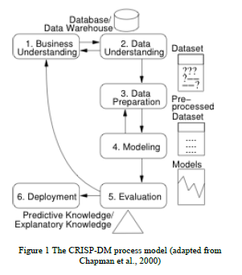
Deployment
Notes:
Constant update your model to keep or improve the accuracy,
Add new variables, and potentially drop other

Slide 25
To Reiterate
Predict if customers will sign up for term deposits
89% success in predicting result!
Important attributes are:
Age, Education, Job
Euribor rate, Employment rate, Consumer Confidence Index
Targeting underserved segments, can improve success rate and increase revenue margins

Slide 26
